Slide 1
Designing custom inconsistent knowledge graphs
MSc Artificial Intelligence Master Thesis
Thomas de Groot

Slide 2
Overview
Introduction
Background
Approach
Method
Internal Validation
Applications
External Validation
Conclusion

Slide 3


Introduction

Slide 4

Introduction

Slide 5
Research Questions
RQ1: Can we define a formal definition?
RQ2: How can we retrieve these patterns?
RQ3: Can we classify the patterns?
RQ4: Can we design methods using patterns?

Slide 6
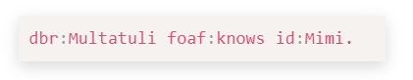
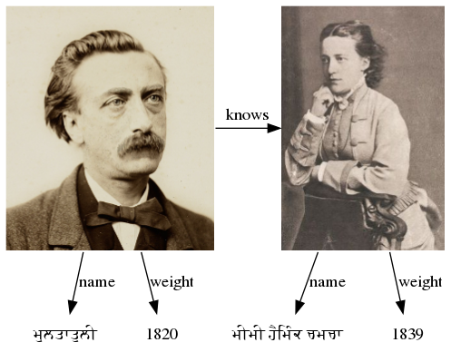
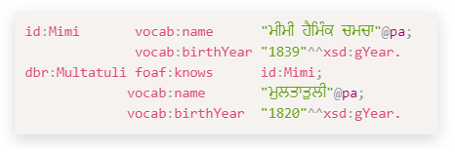
Background
Triple
Graph
Graphical Representation

Slide 7
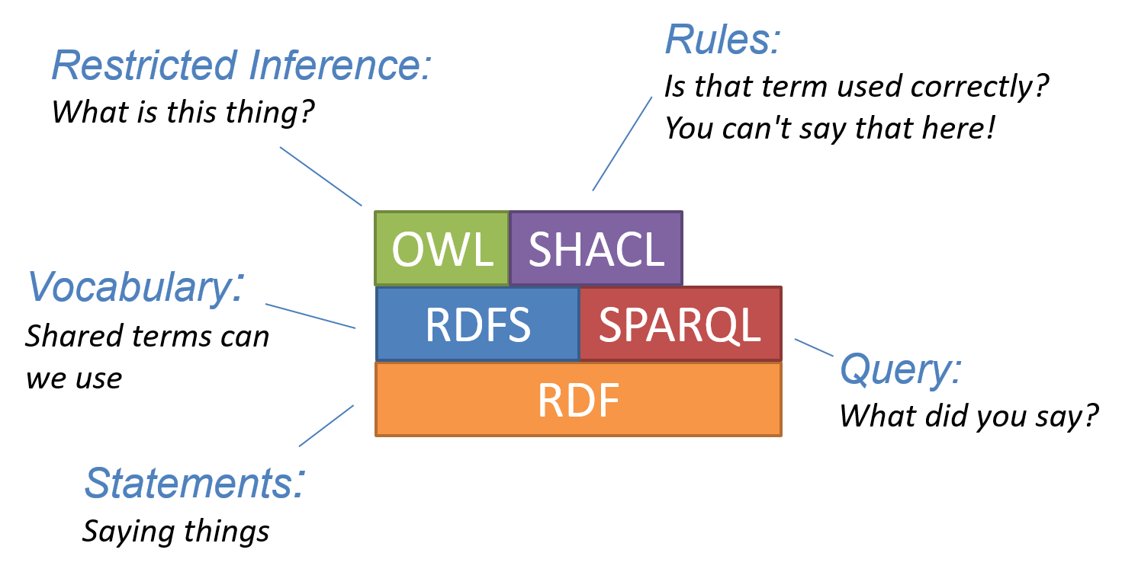
Background

Slide 8
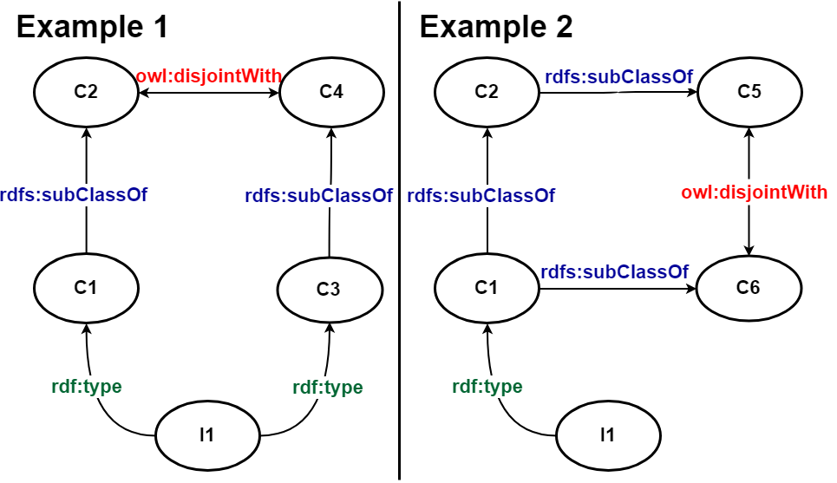
Background

Slide 9
Formal definition of an Anti-pattern
An `Anti-pattern' of a knowledge graph G is a minimal set of uninstantiated Basic Triple Patterns that match an inconsistent subgraph of G.

Slide 10
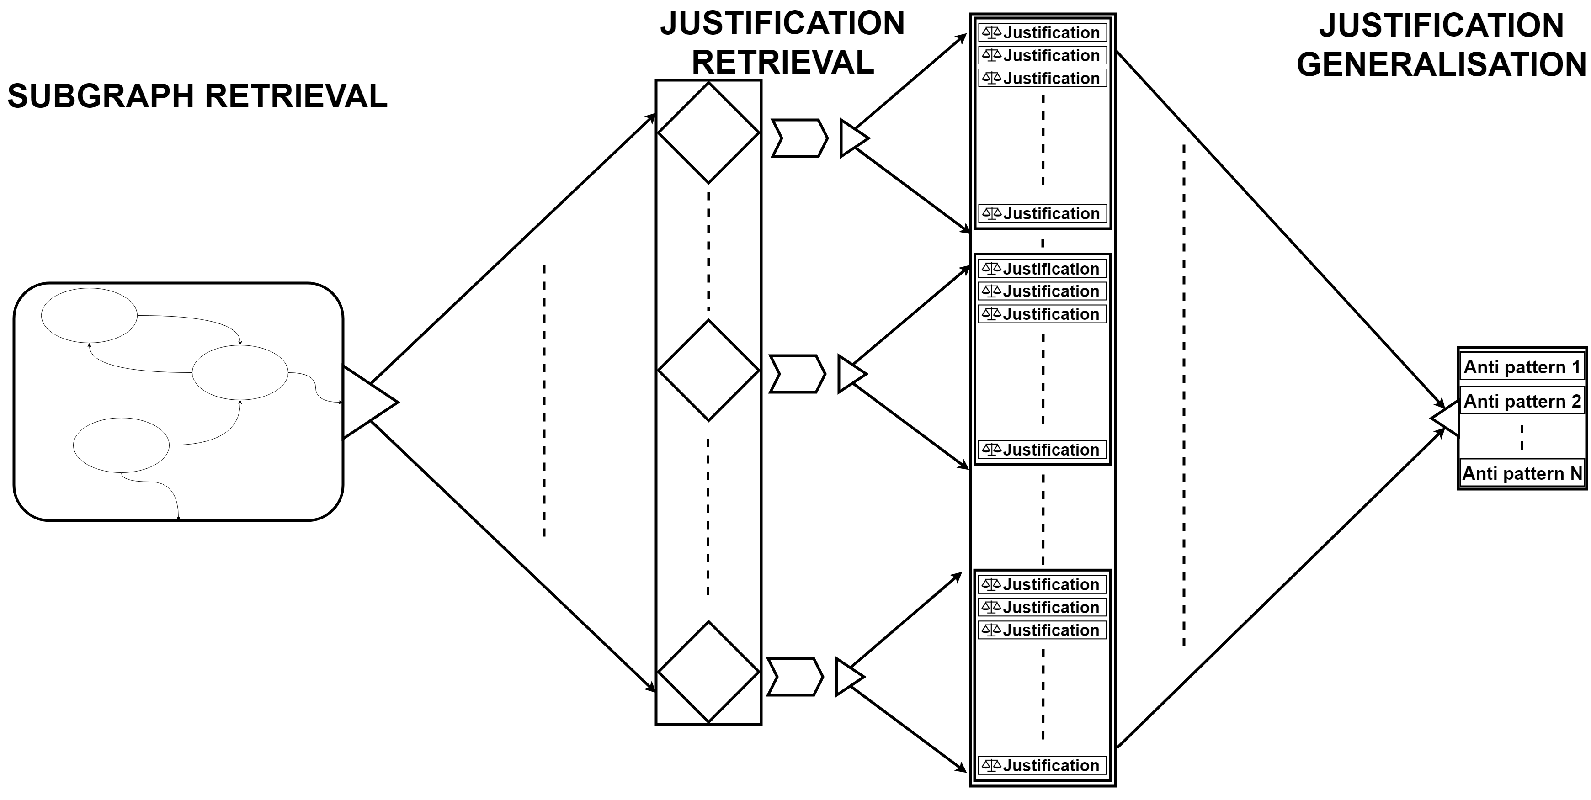
Approach

Slide 11
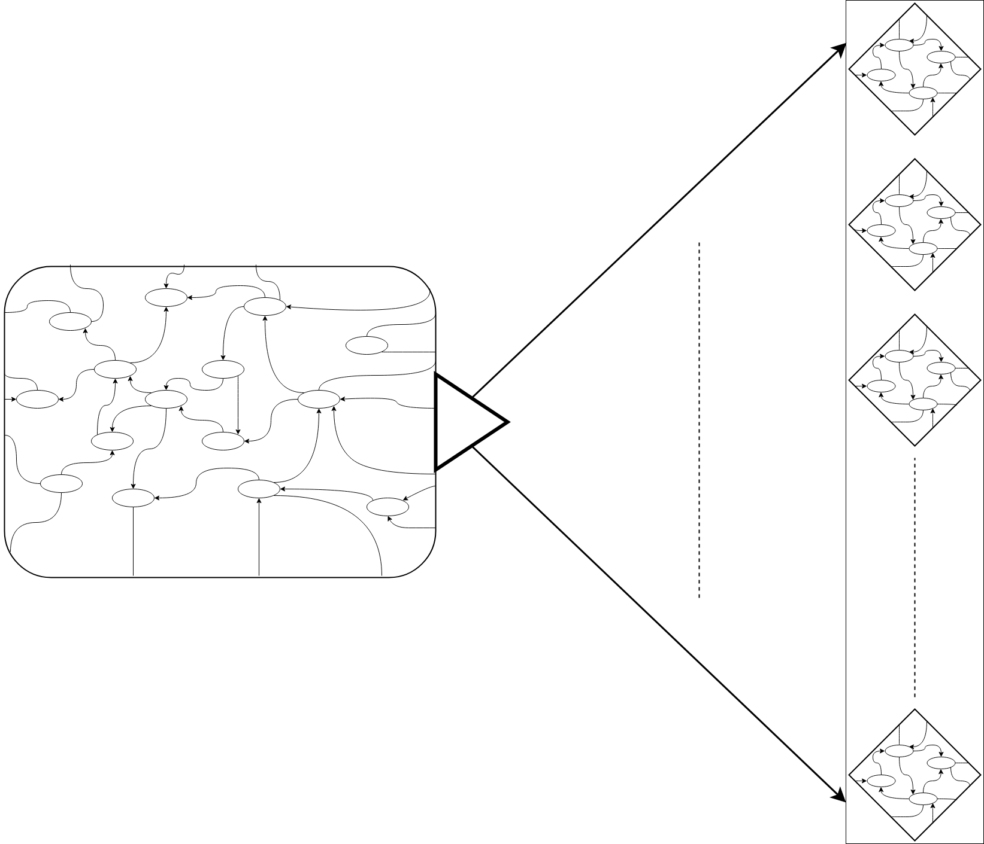
Method
Impractical to retrieve contradictions from the complete graph
Splitting the graph into smaller graphs most viable method
Possible to break existing contradictions
Implement redundancy to combat.

Slide 12
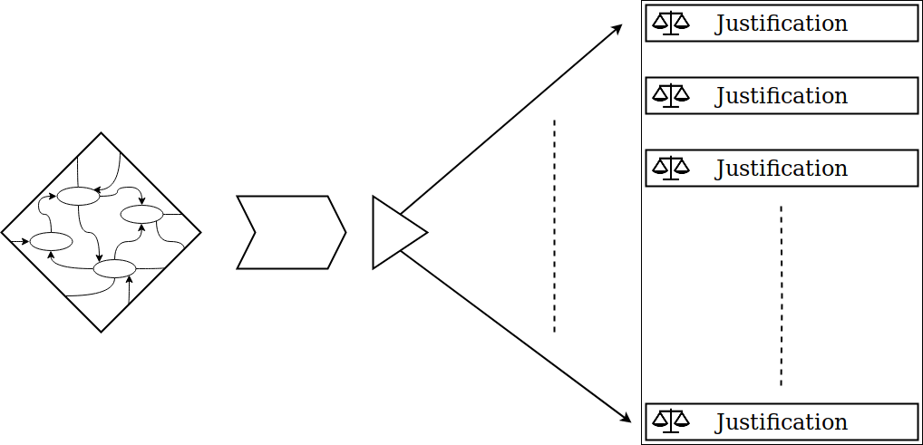
Method
Check if the subgraph is consistent
When the graph is inconsistent retrieve the reasons why.
Find the minimal justification for each contradiction.

Slide 13
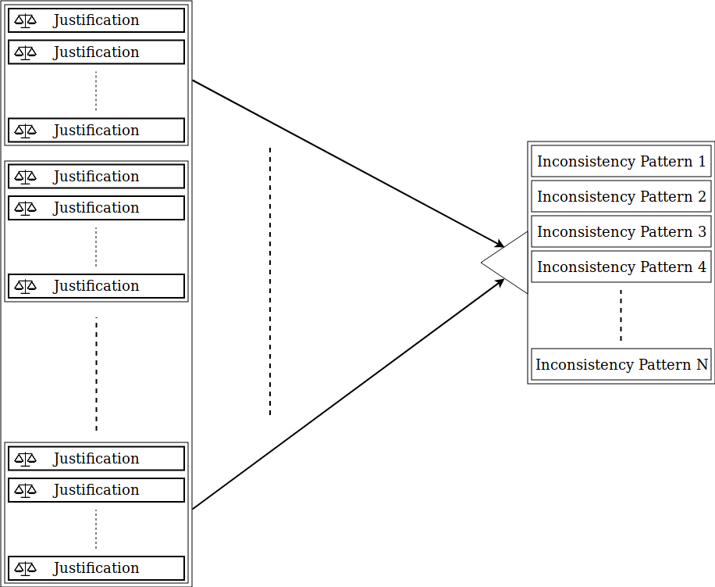
Method
Each justification is transformed in their Inconsistency pattern.
If the consistency pattern is not yet known it is added to the list of inconsistencies.

Slide 14
Data Internal validation
Name | Size
LOD | 28,362,198,927
DBpedia | 1,040,358,853
YAGO | 158,991,568
DBLP | 55,586,971
wordnet | 5,558,748
swdf | 242,256

Slide 15
Data Internal validation
Name | Size | Namespaces | Amount of `Anti-patterns' | Largest Inconsistency
LOD | 28,362,198,927 | - | 222 | 19
DBpedia | 1,040,358,853 | 20 | 13 | 12
YAGO | 158,991,568 | 11 | 135 | 16
DBLP | 55,586,971 | 7 | - | -
wordnet | 5,558,748 | 5 | - | -
swdf | 242,256 | 22 | - | -

Slide 16
Internal validation completeness
 | Inconsistent? | Found inconsistencies
100 triple subgraphs | Yes | 2
500 triple subgraphs | Yes | 2
2,000 triple subgraphs | Yes | 2
Pellet | Yes | 2
HermiT | Yes | 2

Slide 17
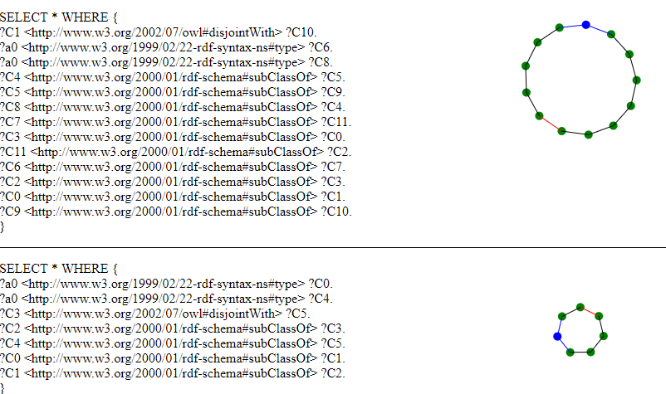
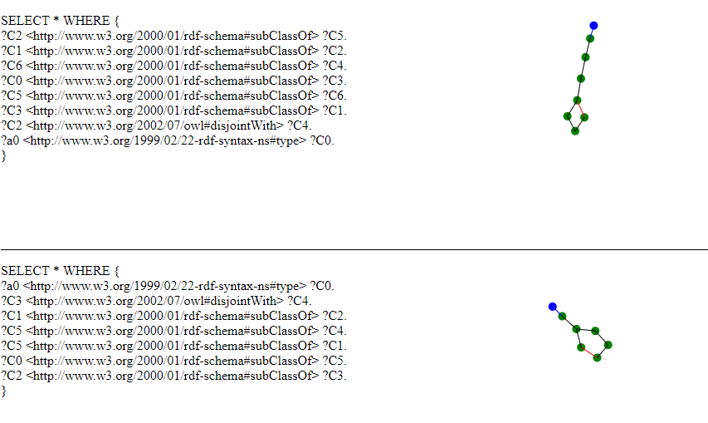
Internal validation

Slide 18
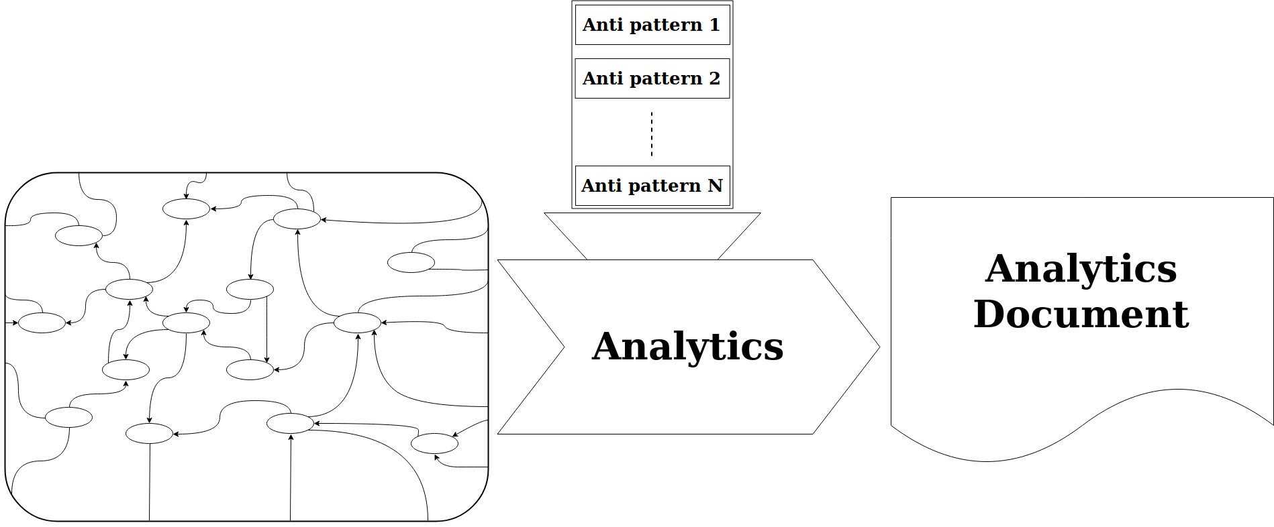
Applications

Slide 19
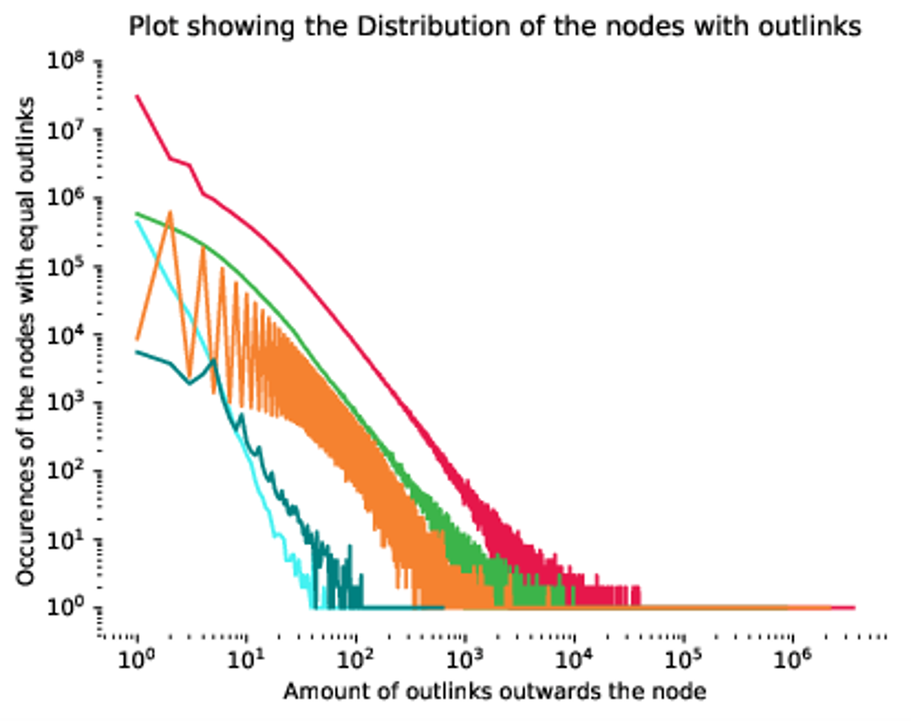
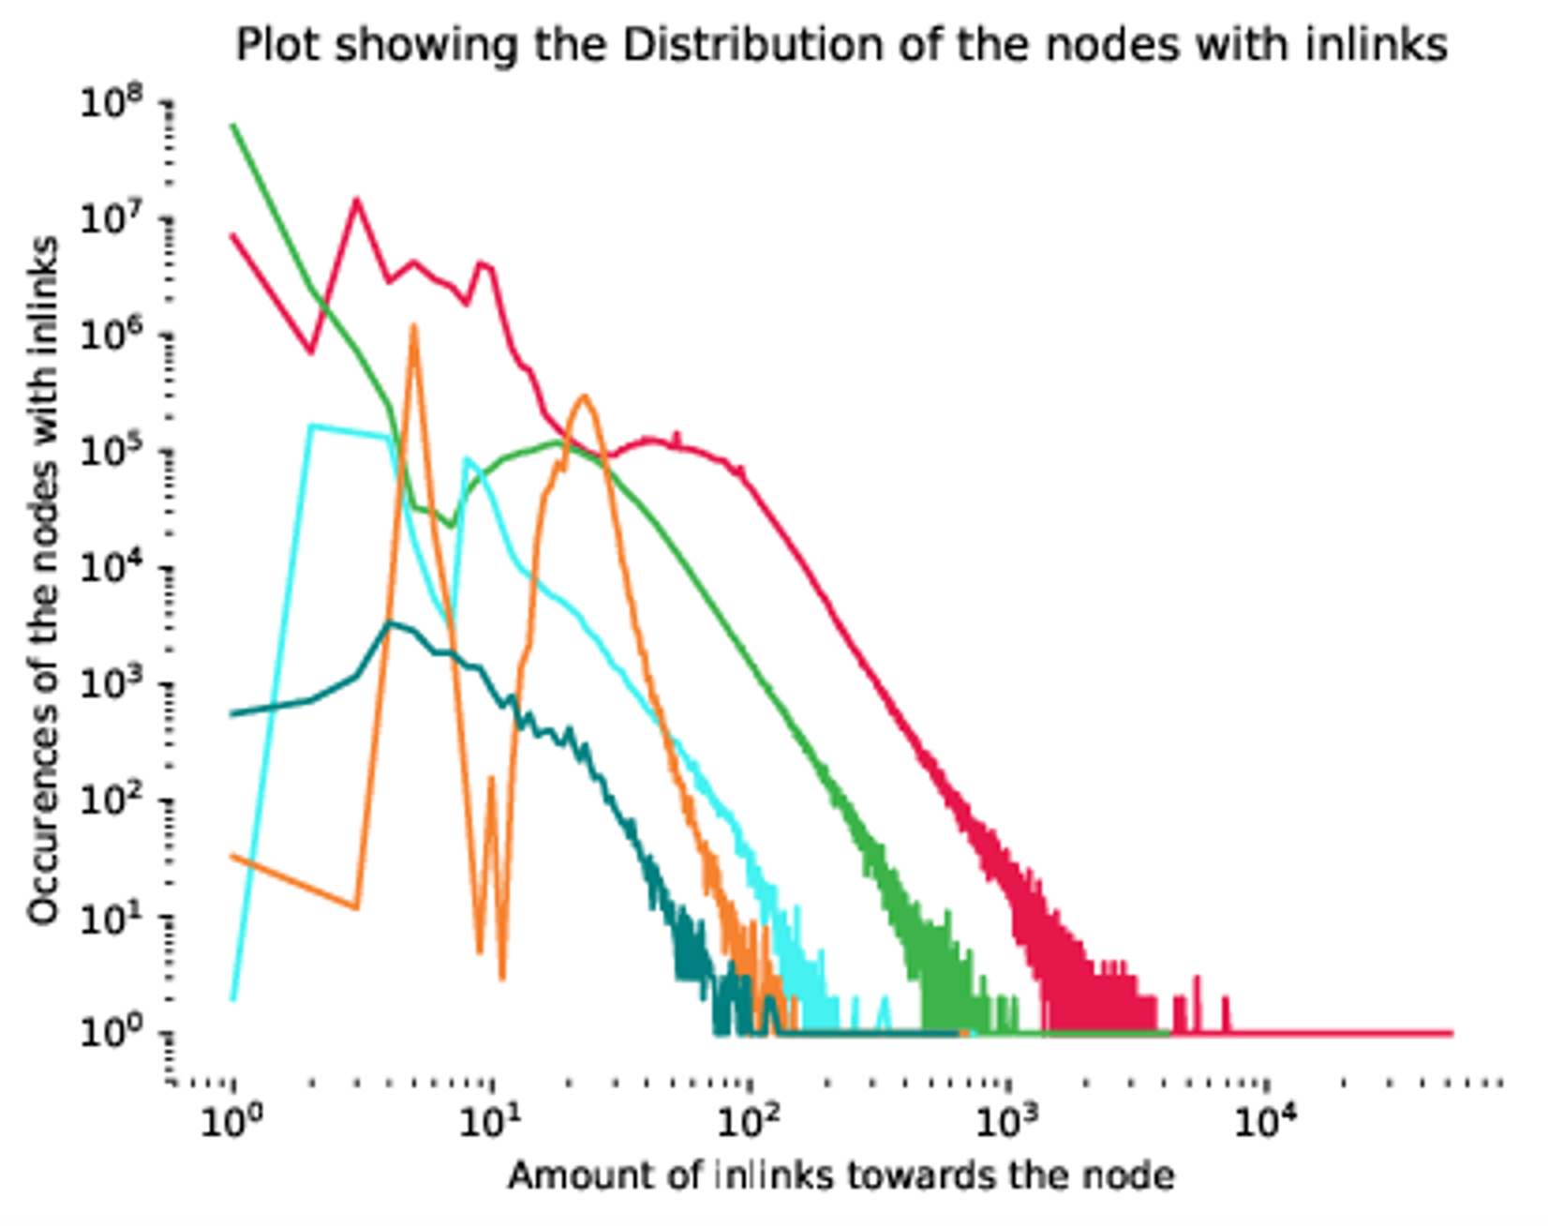

Slide 20
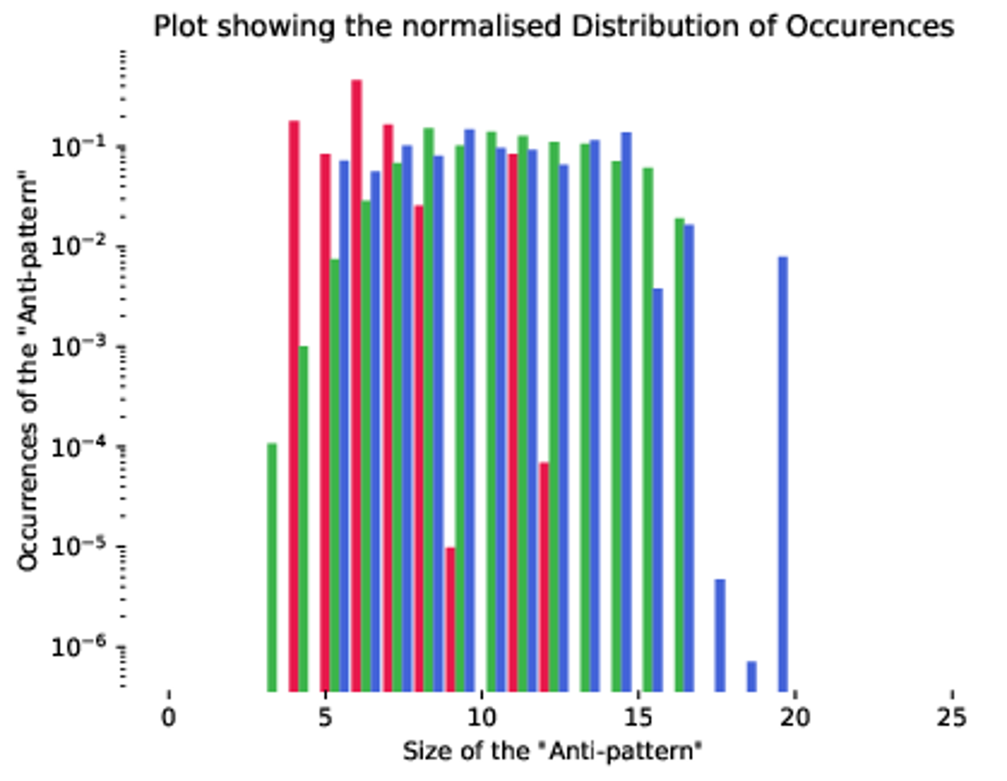
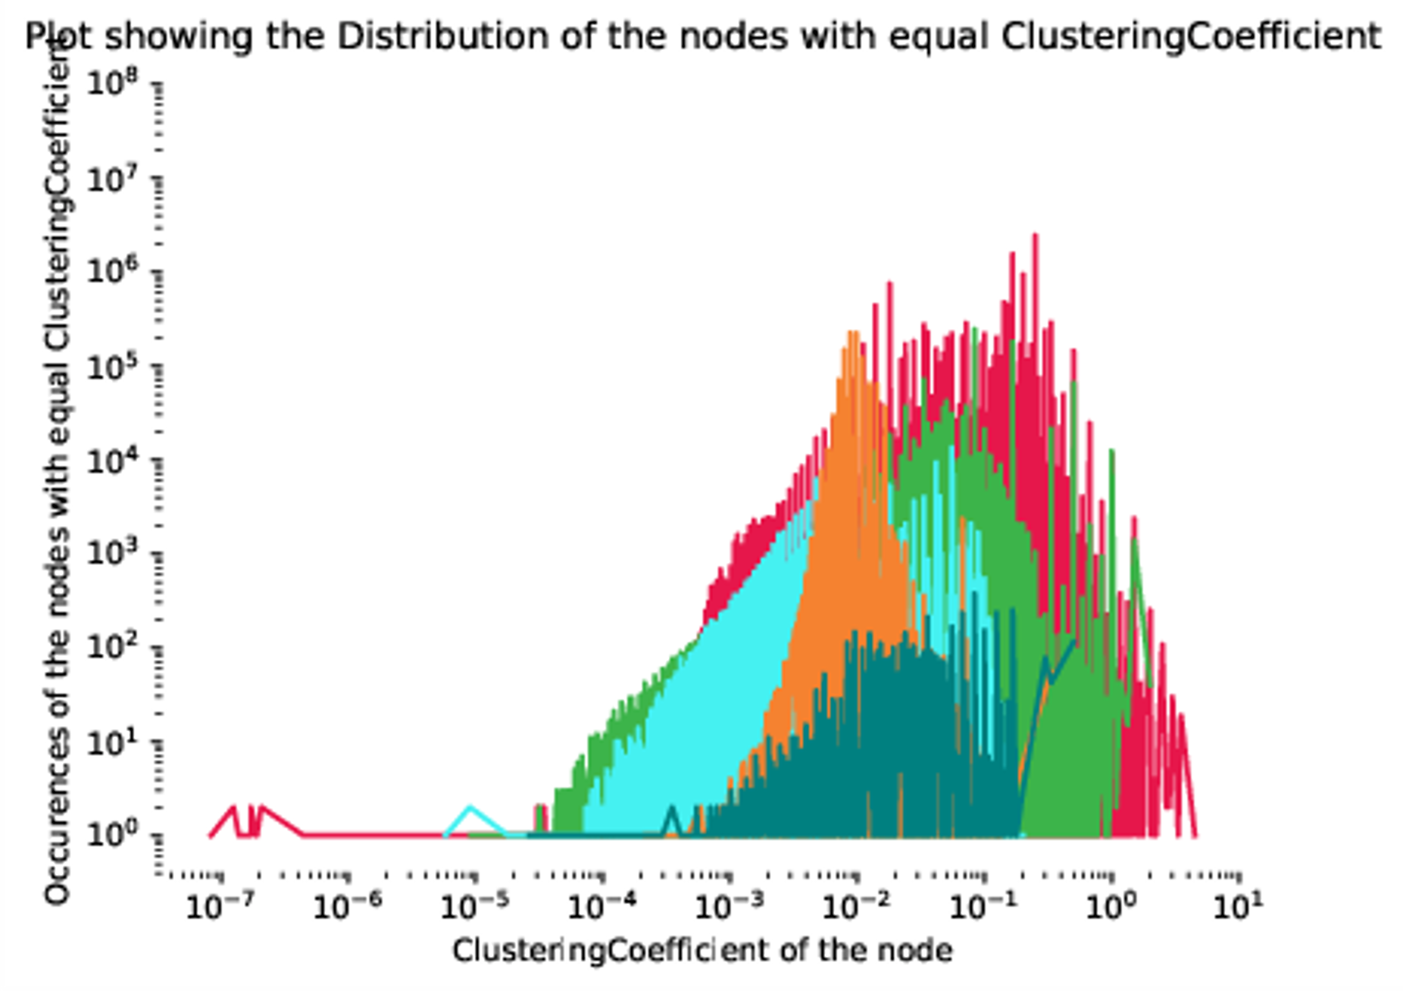

Slide 21
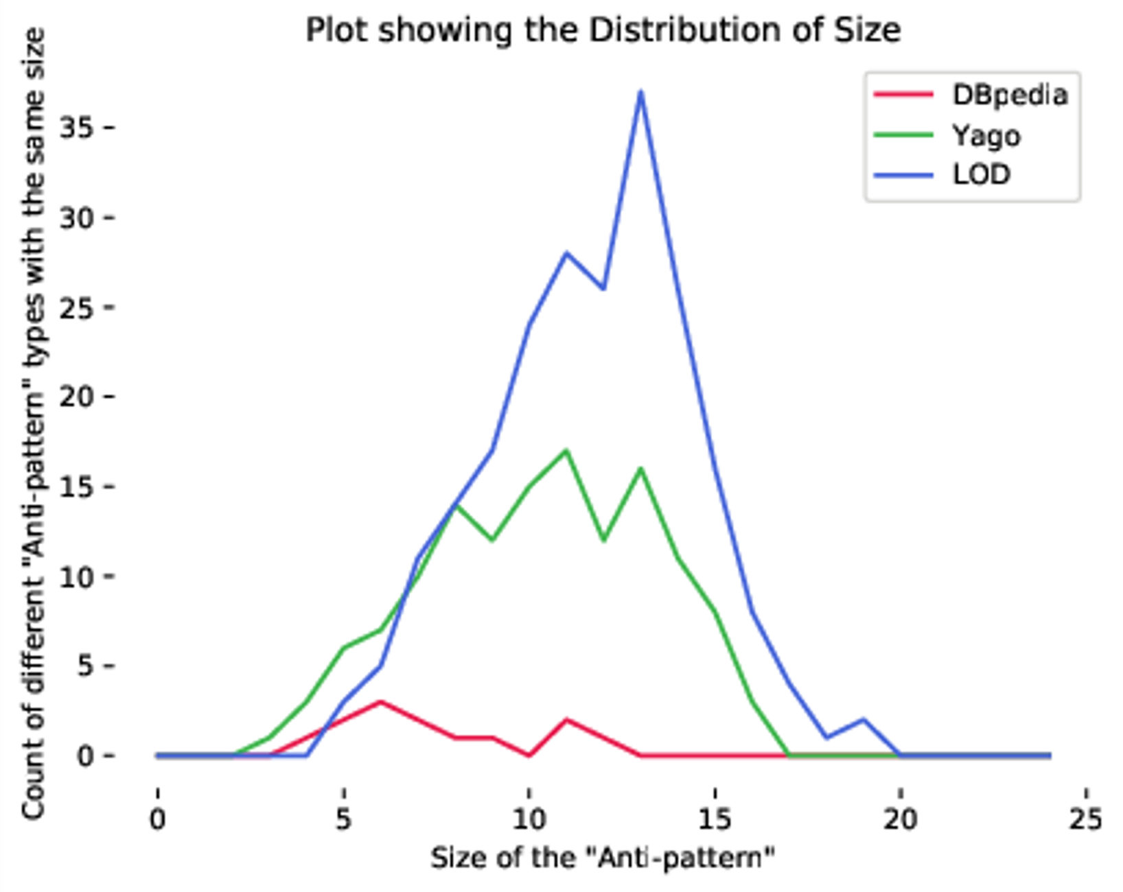
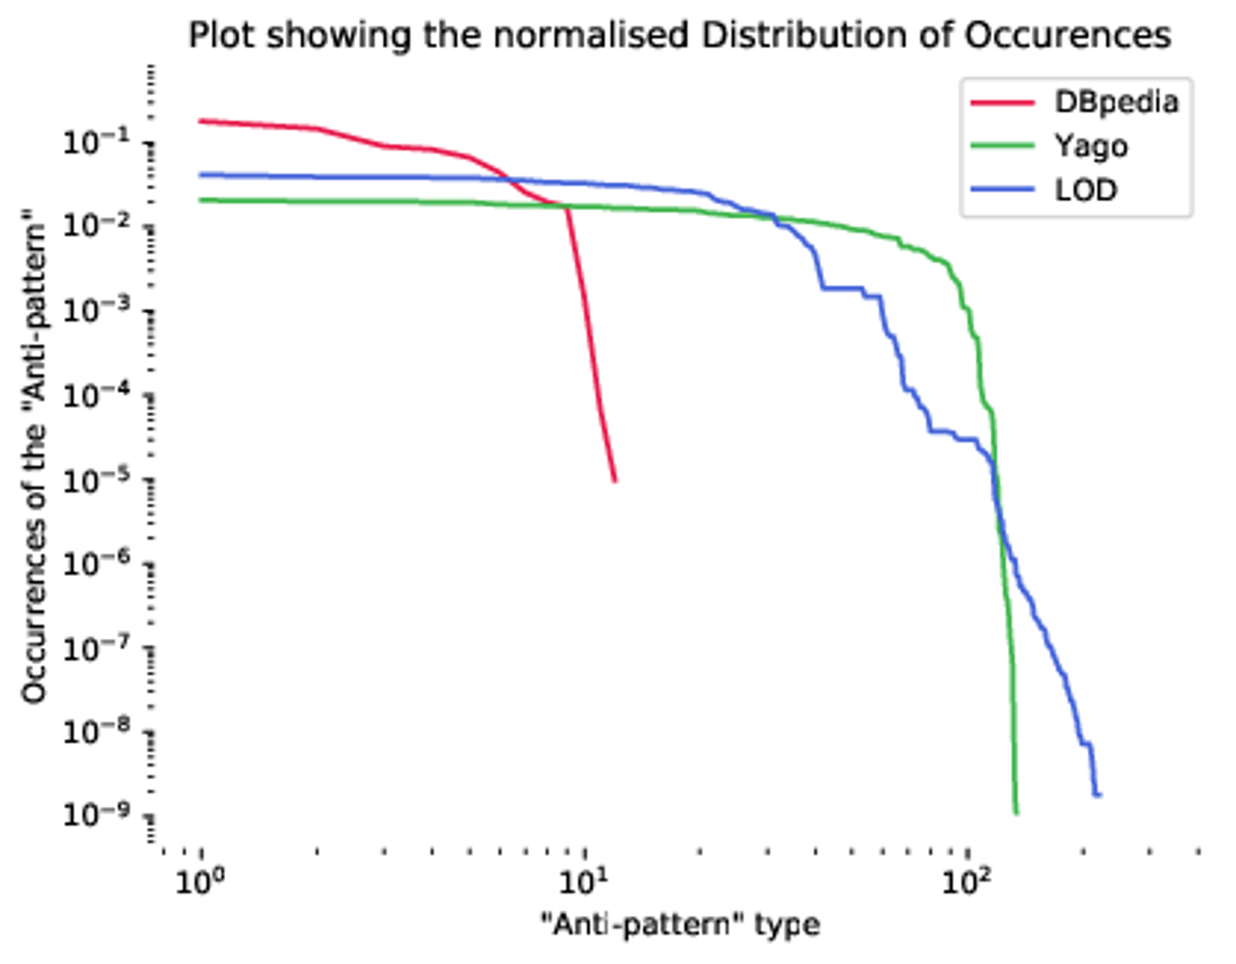

Slide 22
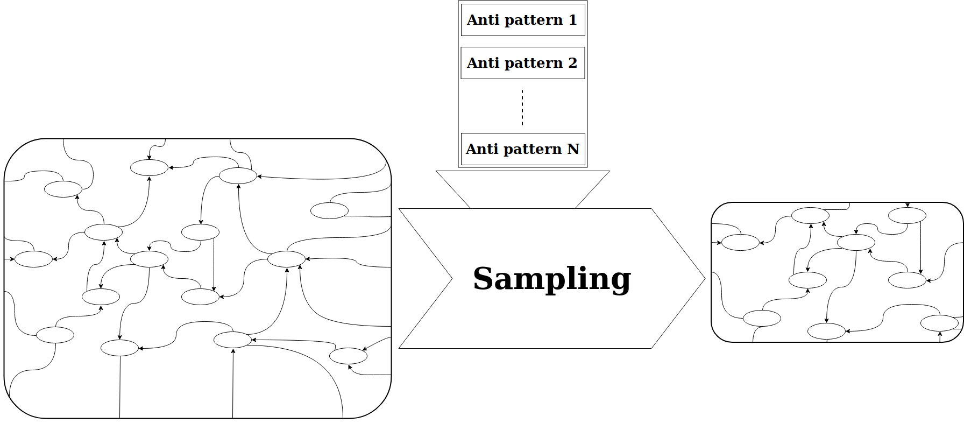
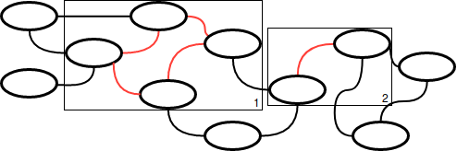
Applications

Slide 23
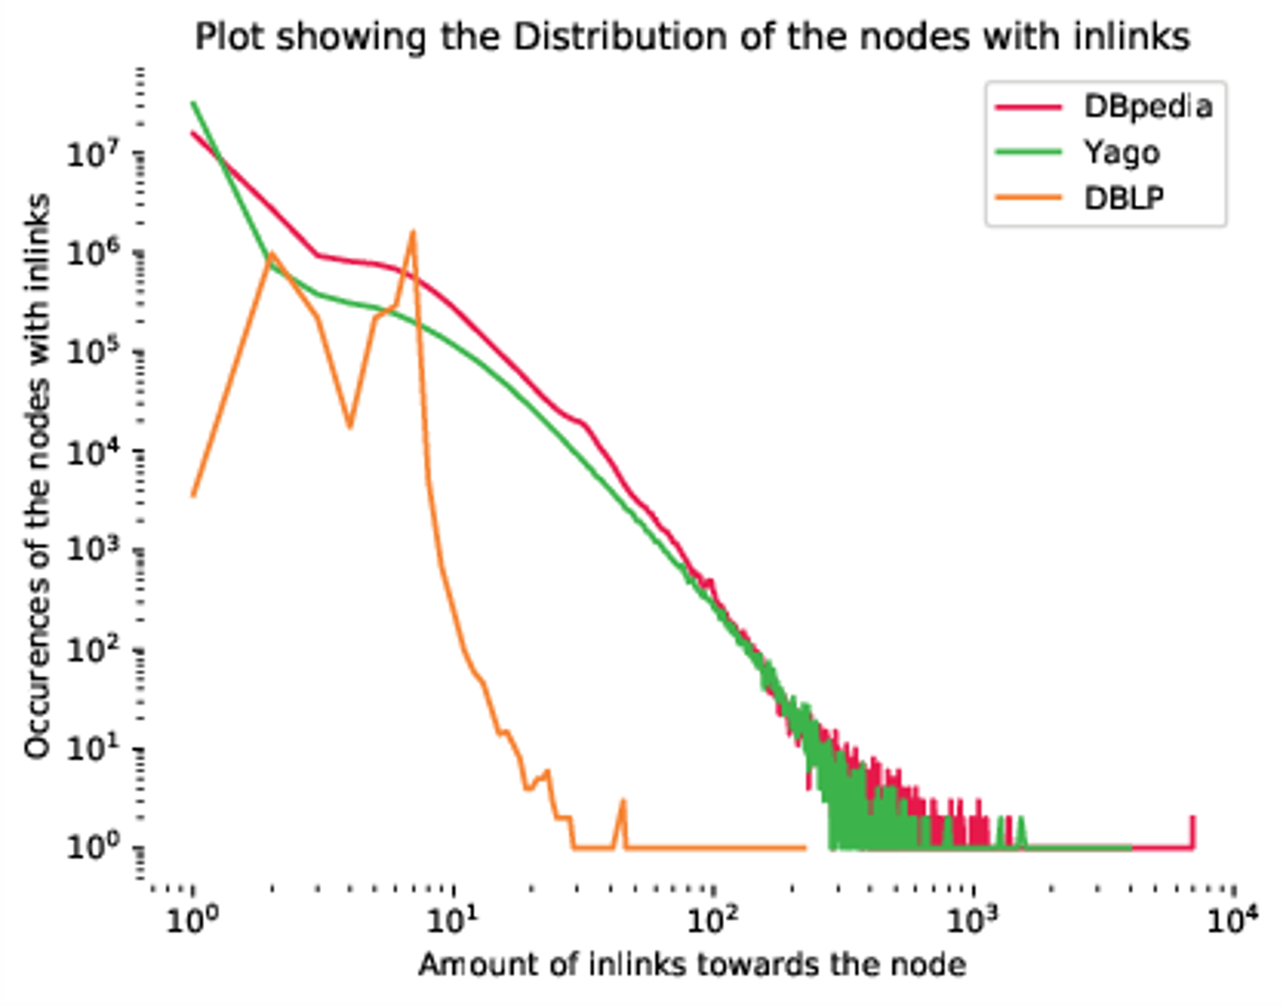
External validation

Slide 24
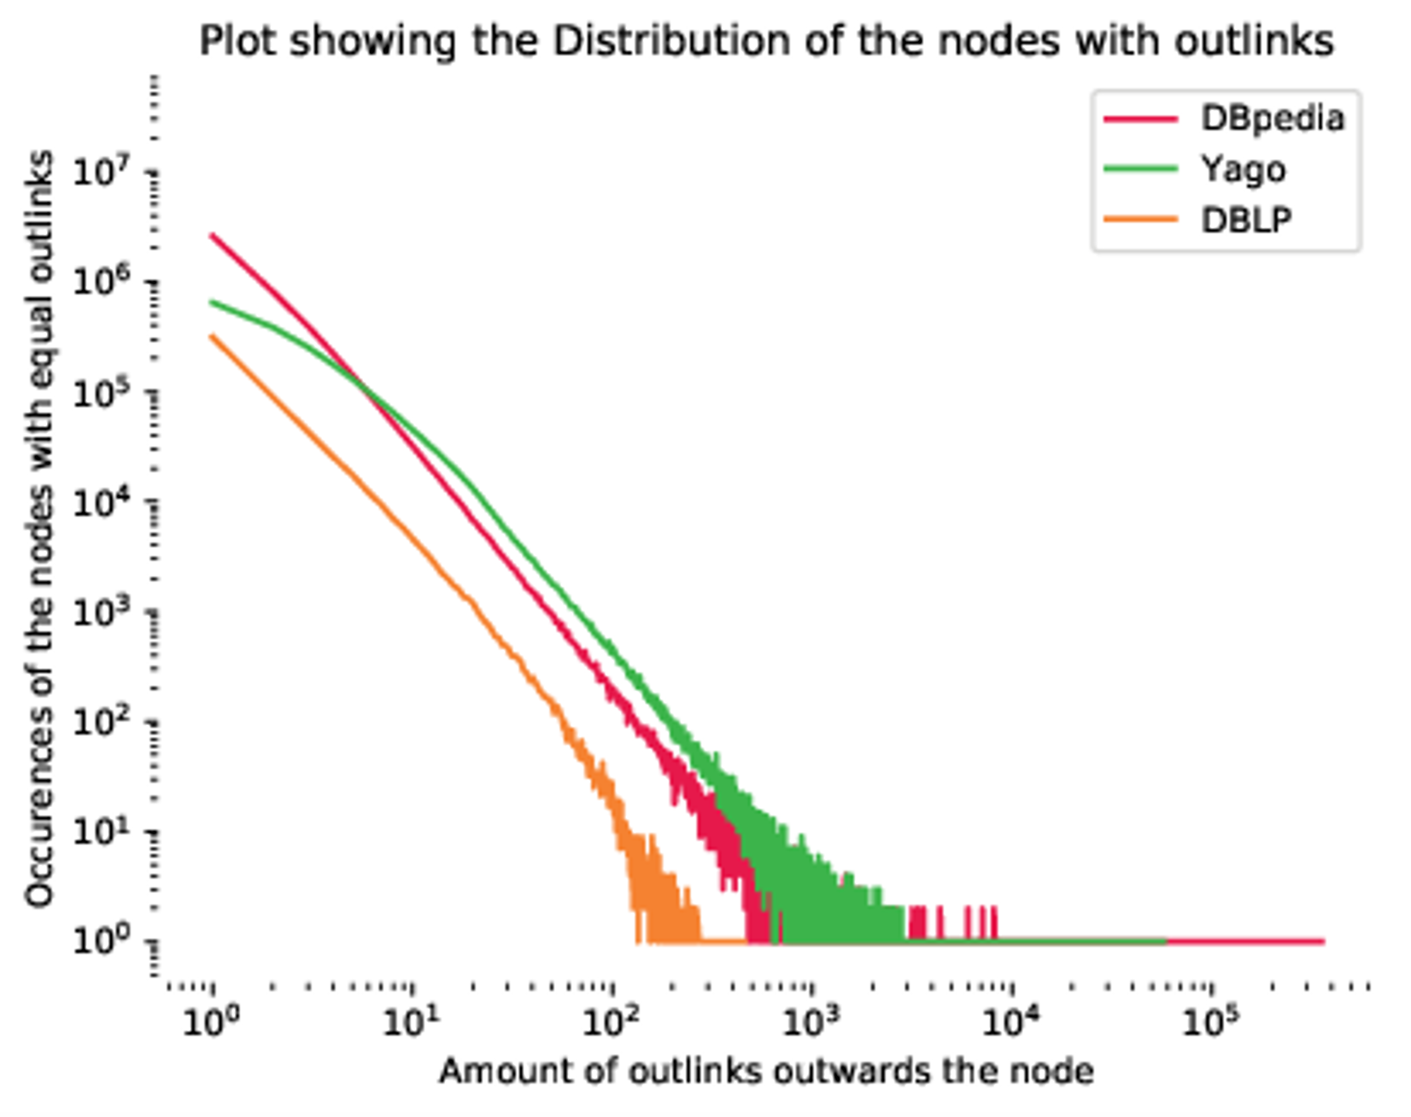

Slide 25
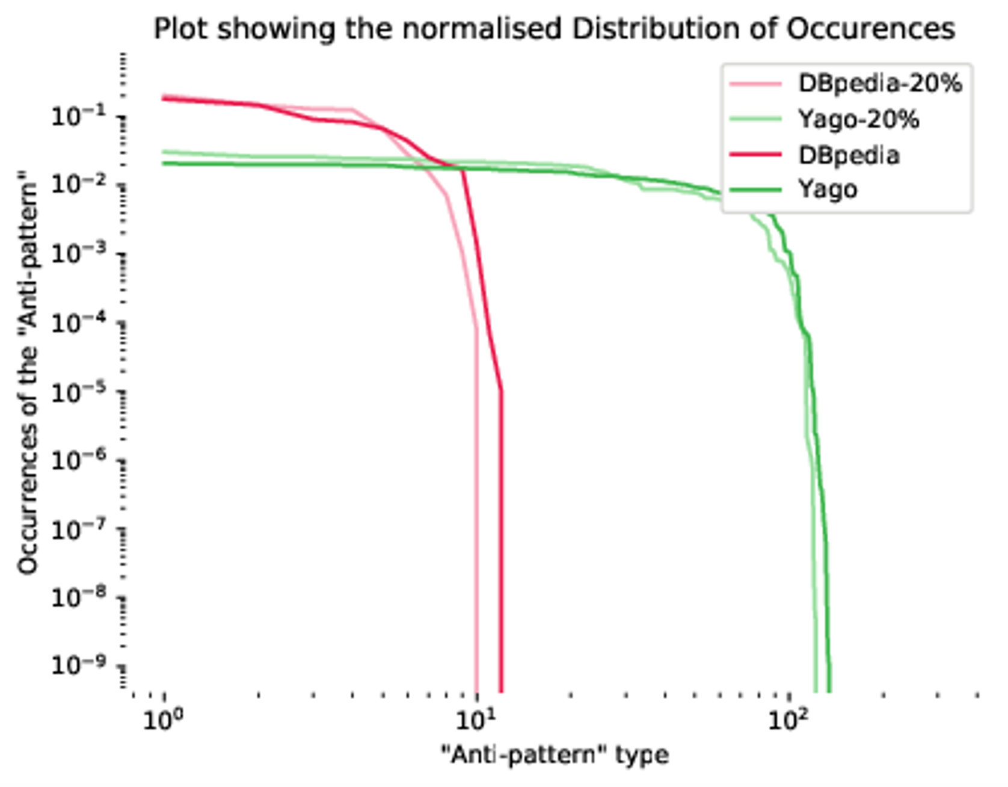
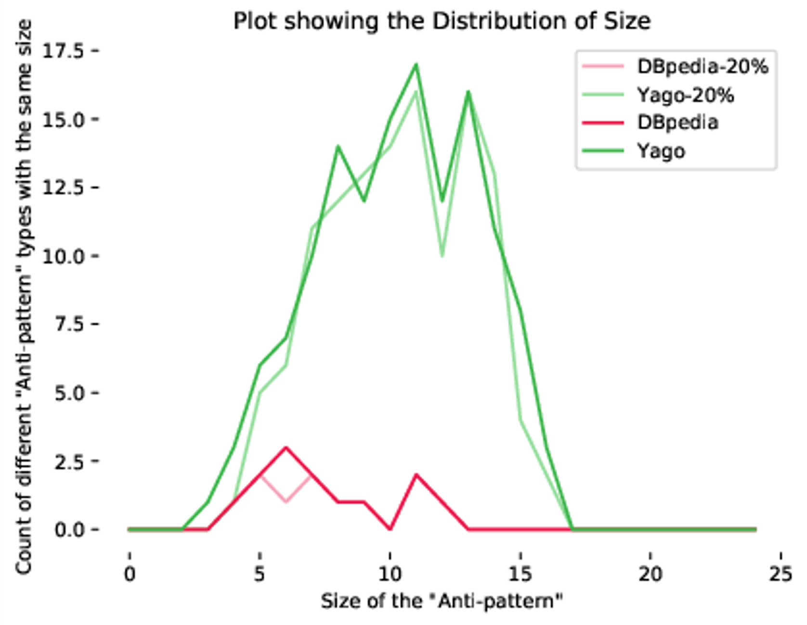

Slide 26

Conclusion
Derived a formal definition of an `Anti-pattern’
Delivered an extraction pipeline.
Implemented two method using `Anti-patterns’
Analysis
Sampling

Slide 27

Future Work
Investigating lesser known knowledge graphs
Improved analysis on ‘Anti-patterns’

Slide 28
FINAL SLIDE
Thank you for your attention

